Slide 1
Evaluating the use of co-created messages and trusted messengers to improve COVID-19 vaccine acceptance in Northern Nigeria
Dr. Chizoba Wonodi
Associate Scientist, Johns Hopkins University –
International Vaccine Access Centre (IVAC)
National Convener, Women Advocates for Vaccine Access (WAVA)
Advisor, Targeted Messaging for COVID-19 Vaccine Acceptance (TM-COVAC), Funded by Sabin Vaccine Institute

Slide 2
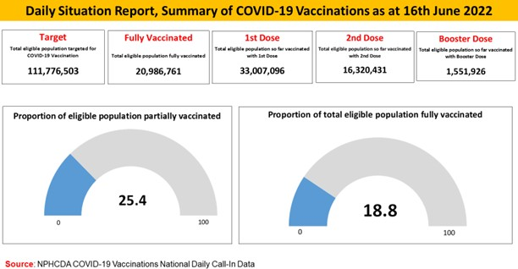
Reasons for hesitancy were conspiracy theories around the virus, the pandemic response, and the COVID-19 vaccine. Concerns about COVID-19
The Problem
Although COVID-19 vaccines are now in adequate supply, Nigeria, like the rest of Africa continues to report low COVID-19 vaccine coverage.
vaccine safety and effectiveness also fuel hesitancy, and VH was higher in North Central and South-East regions¹.
Situation overview
Problem statement
Less than 20% of the population have been fully
The GoN through the NHPCDA is driving communication efforts to promote vaccine uptake. However, most of these efforts are centralized, producing modest effect on vaccine uptake.
vaccinated in Nigeria, in contrast to 67% in the US
Vaccine hesitancy (VH) rates are high among adults
and health care workers (HCWs) in Nigeria
There is a need for effective approaches to inform and influence communities to increase their demand for, and uptake of COVID-19 vaccines.
Having trusted messengers deliver targeted messages that respond to community concerns, holds promise for achieving the behavioral shifts that are needed to raise COVID-19 vaccine coverage in Nigeria
¹ Wonodi C, Obi-Jeff C, Adewumi F, Keluo-Udeke SC, Gur-Arie R, Krubiner C, Jaffe EF, Bamiduro T,
Karron R, Faden F. Conspiracy theories andmisinformation about COVID-19 in Nigeria: implications for vaccine demand generationcommunications. Vaccine. 2022
https://doi.org/10.1016/j.vaccine.2022.02.005
12

Slide 3
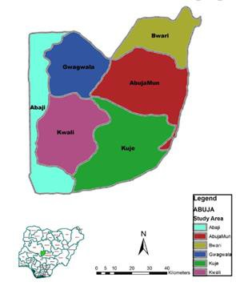
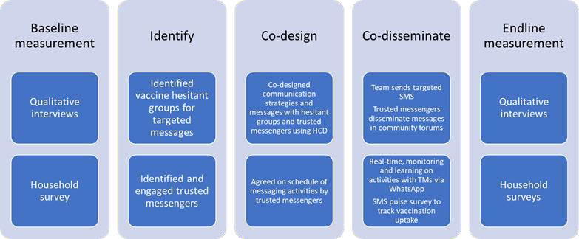
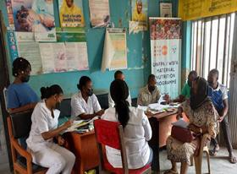
TM-COVAC: is a before-and-after study that aims to use the human-centered design (HCD) approaches to co-design and co-disseminate targeted messages to improve the COVID-19 vaccine uptake among hesitant HCWs and adults. The study is set in all 10 wards in Gwagwalada Area council of FCT, Nigeria.
March – April 2022
April 2022
May – June 2022
July-October 2022
Nov - Dec 2022
FGD with HCWs in primary health facility (rural area), March 21, 2022
Mixed-methods. Measurements ground on the behavioral and social drivers (BeSD) framework
Household surveys of 1,515 eligible adults 18years and above using a two-stage sampling approach
Survey of 139 HCWs selected convenience sampling
Qualitative interviews with 74 purposively selected HCWs, eligible adults, community leaders and program managers at all levels. KII(1), FGDs (8), and IDIs (13)
Framework analysis approach for qualitative interviews and descriptive, bivariate and multivariate analysis of survey using R analysis software
13

Slide 4
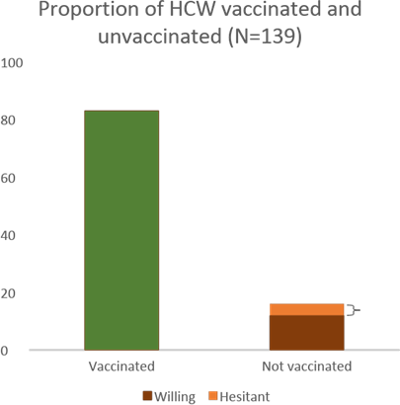
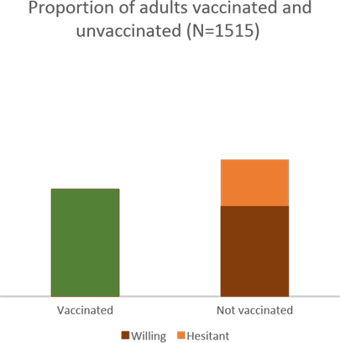
Baseline survey results
Overall vaccination rate was higher in HCWs compared to the adults, however, among the unvaccinated HCWs and adults, vaccine hesitancy (VH) rate was similar at 34%
83% (N=115)
56% (849)
44% (N=666)
34% VH rate
among unvaccinated
adults
17% (N=24)
34% VH rate
among unvaccinated
HCWs
Of the 24 unvaccinated HCWs, 34% were hesitant or unsure (VH). Overall hesitancy/undecided rate among sample of HCW was 5%
Of the 849 unvaccinated adults, 34% were hesitant or unsure (VH). Overall hesitancy/undecided rate among adult sample was ~19%₁₄

Slide 5
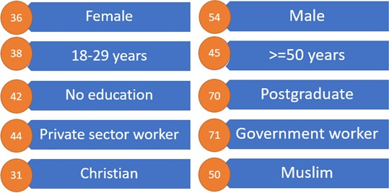
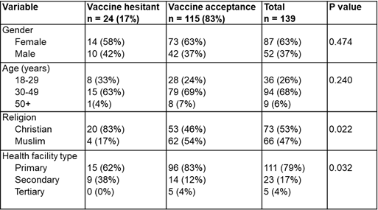
Baseline survey results
COVID vaccination rate (%) among HCWs by key demographic
characteristics
COVID vaccination rate (%) among adults by key demographic characteristics
Major reasons for vaccine hesitancy were:
practical issues- lack of knowledge on where to get vaccinated (49%), vaccine not offered yet (44%), vaccine unavailability (31%), inability to access vaccines (27%), far vaccination site (14%);
Thoughts and feeling issues- concerns about COVID-19 vaccine safety
(31%), side effects (29%), and efficacy (28%); and
Social processes issues- distrust in government (11%).
Major reasons were concerns about the vaccine’s safety
(31%) and side effects (28%), and other.
Multiple responses were allowed
15

Slide 6
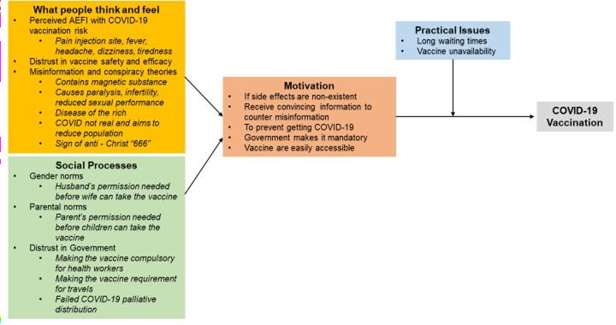
Baseline qualitative results
Qualitative interview findings
Most cited socio-behavioral drivers of COVID-19 vaccine hesitancy from the qualitative
interviews
6

Slide 7
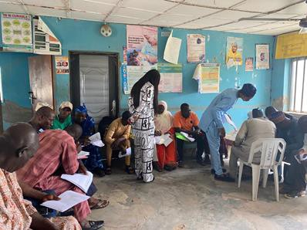
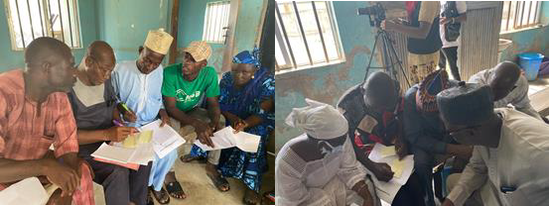
Key Learnings
Involving trusted community members and vaccine hesitant eligible adults was feasible in developing a repository of evidence-based targeted messages and communication strategies to address COVID-19 vaccine hesitancy
Leveraging existing community structures and platforms to co-develop and co-disseminate targeted messages is essential for sustainability
A bottom-up approach and involvement of trusted community members in diagnosing and solving their issues themselves is highly encouraged, and engenders community participation and ownership
Involving program managers in the HCD process also built their skills on how to use an HCD approach to design context- specific solutions to improve community acceptance of interventions including vaccinations
Recruiting vaccine hesitant HCWs was challenging due to fear of losing their jobs and stigmatization.
HCD co-creation sessionand message testing with trusted COVID-19 vaccine messengers, May 25, 2022
7

Slide 8
A project by WAVA in collaboration with Direct Consulting and Logistics (DCL) Nigeria
We are grateful for the funding support from the Sabin Vaccine Institute
THANK YOU

