Slide 1
Why vaccination-related restrictions work(ed) in Pakistan?
Muhammad Faisal Khalil
Social and Behavioral Scientist, UNICEF Pakistan

Slide 2
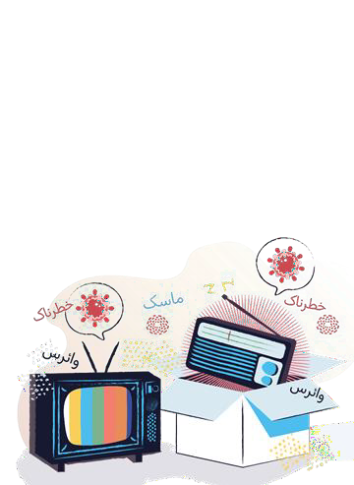
The Problem
Situation overview
Persistent vaccine hesitancy: 40% (April ’22)
Very low risk perception: 28% (April ’22)
Extremely low COVID-19 prevention: 3.35% (Sep ‘21)
Extremely low knowledge of variants: 5% (April ’22)
Government used strategy of vaccination-related restrictions to influence health-related behaviours and generate demand for vaccines i.e. outweighing certain rights to achieve public-health benefit
Problem statement
How do you achieve vaccination compliance in a population that is significantly vaccine hesitant?
Key crisis: Emergence of viral variants
Key constraint: Limited resources for standard strategies to increase uptake e.g.
Community engagement;
Tailored communication to hesitant populations from trusted sources; and
Flexible access to vaccination for at-risk and vulnerable groups.
20

Slide 3
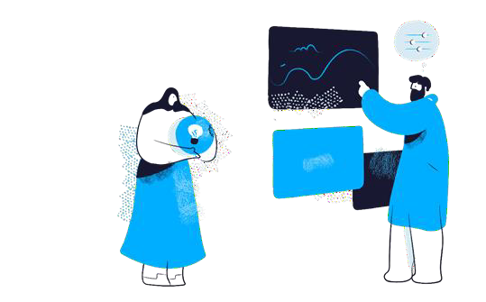
The Solution
Actions
Government introduced vaccination as a condition to access:
Public goods e.g. education and public offices
Livelihood e.g. employment or employment salary and benefits
Communications e.g. cellphones, transportation, air travel
Association: congregational prayer, religious events, wedding ceremonies, funerals.
Key features:
Prioritised but granulated: targeted at-risk and vulnerable first; then opened up to all other subgroups across gender, age, location, socioeconomic classification.
Proximate: were not far away in time but immediate.
High likelihood of detection: Used centralised mechanisms to detect non-compliance e.g. national database
Effectiveness of these restrictions was measured using longitudinal KAP surveys as well as social media listening and feedback capture from the national helpline.
This was corroborated with incoming data on vaccination uptake.
21

Slide 4
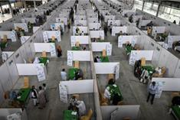
Outcomes and Key Learnings
Outcomes and Impact
With technical assistance from UNICEF Country
Office, federal government achieved high vaccine compliance (82%) despite the persistent vaccine hesitancy (40%).
61% of vaccine hesitant Pakistanis got vaccinated
(75% who were unsure and 61% who were sure): 21% of overall population.
Key reason for vaccinationwas not health but overcoming vaccine-related restrictions.
Key Learnings
Key enablers:
Whole-of-society effect.
Centralised delivery mechanism
Clear public communication using high-frequency channels.
high-exposure,
Key challenges:
Not all subgroups trust, or are affected by, government: outliers e.g. young people and the province of Baluchistan.
Long-term efficacy, given ethical concerns and community resistance to restrictions as public health benefits become more low stake or vague over time.
Develop country-specific ‘algorithms’ that help interventions determine whether, which and when restrictions should be used to achieve vaccination compliance.
22

Slide 5
Muhammad Faisal Khalil
Social and Behavioral Scientist, UNICEF Pakistan
THANK YOU

