Slide 1
Translating Evidence to Action:
An Event-Based Vaccination Approach in Tanzania
Chima E. Onuekwe
Risk Communication and Community Engagement Officer
World Health Organization, Tanzania

Slide 2
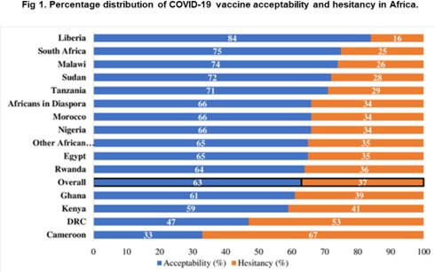
The Problem
Situation overview
Tanzania is among few countries that did not introduce any form of public health restrictions during the peak of COVID- 19 infection
7.7% Tanzanians have received at least one dose of a COVID-19 vaccine
Vaccines are available at all health facilities, but low utilization
Information environment did not position COVID-19
vaccination as urgent or important
Social norms around COVID-19 vaccination are poor
Studies confirmed that people knew why and where to get vaccinated, trusted the vaccine safety and efficacy, and have high intentions, yet not getting vaccinated
PLOS ONE. Dec2021
https://doi.org/10.1371/journal.pone.0260575
Problem statement
71% of Tanzanians are willing to get vaccinated, however only 7.7% are vaccinated as at 20 June 2022.
7

Slide 3
The Solution
Actions
Same Day Health Facility vs. Events-Based Vaccination
S/ n | Region | HFs Average Daily #Vx | 1-day Football Event # Vx
1 | Dar es Salaam | 5 | 95
2 | Kagera | 2 | 28
3 | Lindi | 2 | 25
4 | Mbeya | 2 | 48
5 | Morogoro | 4 | 36
6 | Mwanza | 2 | 46
7 | Pwani | 3 | 31
8 | Tanga | 2 | 38
Implemented event-based vaccination to
address practical factors and social barriers
Compared event-based with fixed-site vaccination from the same regions and day
Comparative analysis of health facility and event-base vaccination data.
Leveraged highly visible events such as football games to promote COVID-19 vaccination on communication channels and products including mass media, social media, below-the-line
Carried out interviews and focus group discussions to ascertain the barriers to health facility vaccination
Developed the “rolling sleeves” gesture as a
symbol for vaccination support
Partnered with match organisers to offer free football tickets to those who got vaccinated against COVID-19
“Though, I am willing and
interested to get vaccinated, going to the health facility would waste my time and money” - FGD participant
Total vaccinated in 8 HFs = 22;
Total vaccinated in 8 football events = 347
8

Slide 4
Outcomes and Key Learnings
Outcomes and Impact
Successfully leveraged media visibility around the football matches and players as advocates for vaccination:
990 visibility materials, 106 mentions produced and amplified on radio
Delivered key messages in support of COVID-19 vaccination at 8 football events
Key Learnings
Event-based vaccination can be a successful approach when combined with health facilities and mobile outreach strategies in settings with complacency towards vaccination, lack of convenient services and lack of supportive social norms
Highly visible events with a lot of media attention provide a high- impact platform:
For public communications on vaccination
For engagement of key influencers as advocates
Vaccinated 661 persons at the football games
For M&E, compared number of vaccinations from the same days and regions: fixed site vs. event-based vaccination
Future research question:
Rapid exit interviews and focus groups to determine why same persons willing to vaccinate and knowing the importance of COVID-19 vaccination wouldn’t visit a health facility, however will accept the same vaccination at an event or through outreach.
9

Slide 5
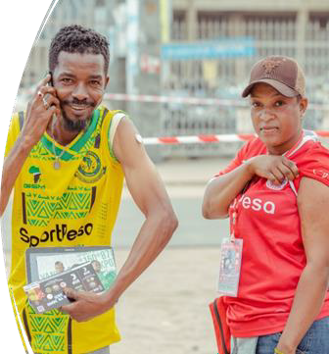
Risk Communication and Community Engagement
Chima E. Onuekwe
Officer,
World Health Organization, Tanzania
THANK YOU

