Slide 1
Aishath Thimna Latheef National Professional Officer, WHO Maldives Dr Lokesh Alahari Consultant, WHO Maldives

Slide 2
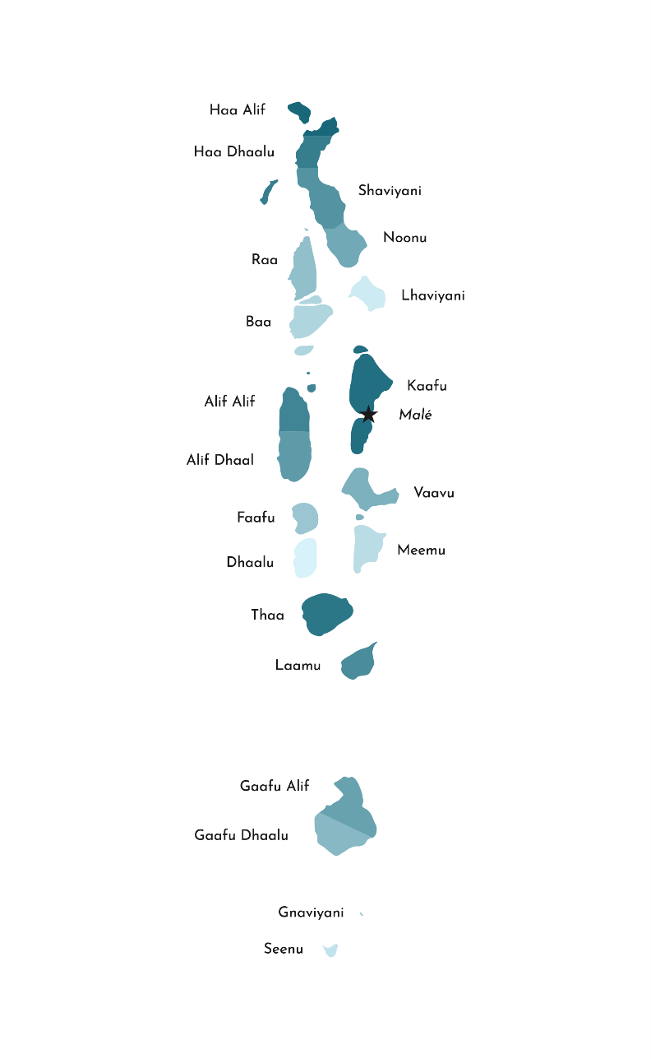
Introduction
One of the most geographically dispersed nation
1,192 islands (grouped into 20 atolls), 187 Inhabited Islands, 166 resort islands
Total population of 545,847
Functional health centre/hospital at each island/atoll with a team of doctor, nurses and public health workers
More than 10% of GDP is spent on healthcare. Highest in the region
Universal health insurance scheme financed by Government (Aasandha)
Tourist nation (Approximately 1.5 million arrivals in a year)

Slide 3
COVID-19 Vaccination Overview
COVID-19 vaccination started 1 February 2021
Vaccines for primary series: Covishield-SII, Sinopharm, Astra Zeneca, Pfizer-BioNTech
Vaccine used for booster dose: Pfizer BioNTech
Current age eligibility:
Primary series: 12+ years
Booster dose: 18+ years
Equitable and free of cost vaccination: open to all including expatriates and undocumented migrants
Data as on 13-February-2022

Slide 4
Joint COVID-19 & HPV Vaccines PIE: Objectives
Main objective:
Evaluate the deployment of COVID-19 vaccines in the country and introduction of HPV vaccine in the national immunization programme
Specific: objectives:
Identify strengths & challenges in planning & deployment (COVID-19 & HPV)
Review implementation of the recommendations from 2019 EPI review (HPV)
Highlight lessons for strengthening national immunization system and services especially as they relate to specific target groups (e.g. adolescents, elderly, persons with co-morbidities); (COVID-19 & HPV)
Inform recommendations to correct problems & implement improvements for ongoing deployment (COVID-19 & HPV)
Share lessons learnt (COVID-19 & HPV)

Slide 5
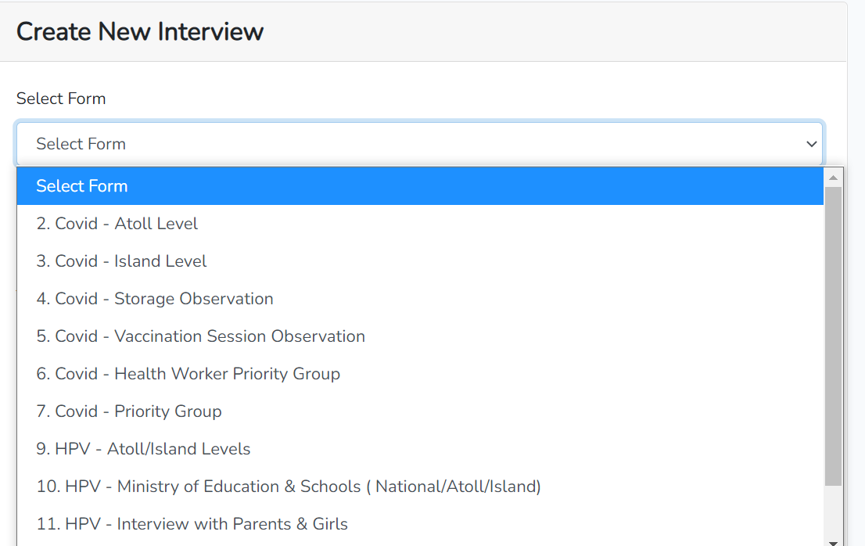
Joint cPIE and HPV PIE- salient features
Maldives is one of the first countries to conduct a classic PIE for COVID-19 vaccination and this was coupled with HPV vaccine PIE
A "real-time online data collection tool” in a web portal and used
The classic PIE exercise evaluated all aspects of COVID-19 and HPV vaccines roll-out
High level of political commitment for PIE: Briefing and debriefing meetings were chaired by HE Minister of Health, and attended by all senior officials of health department, members of technical advisory bodies and immunization partners.

Slide 6
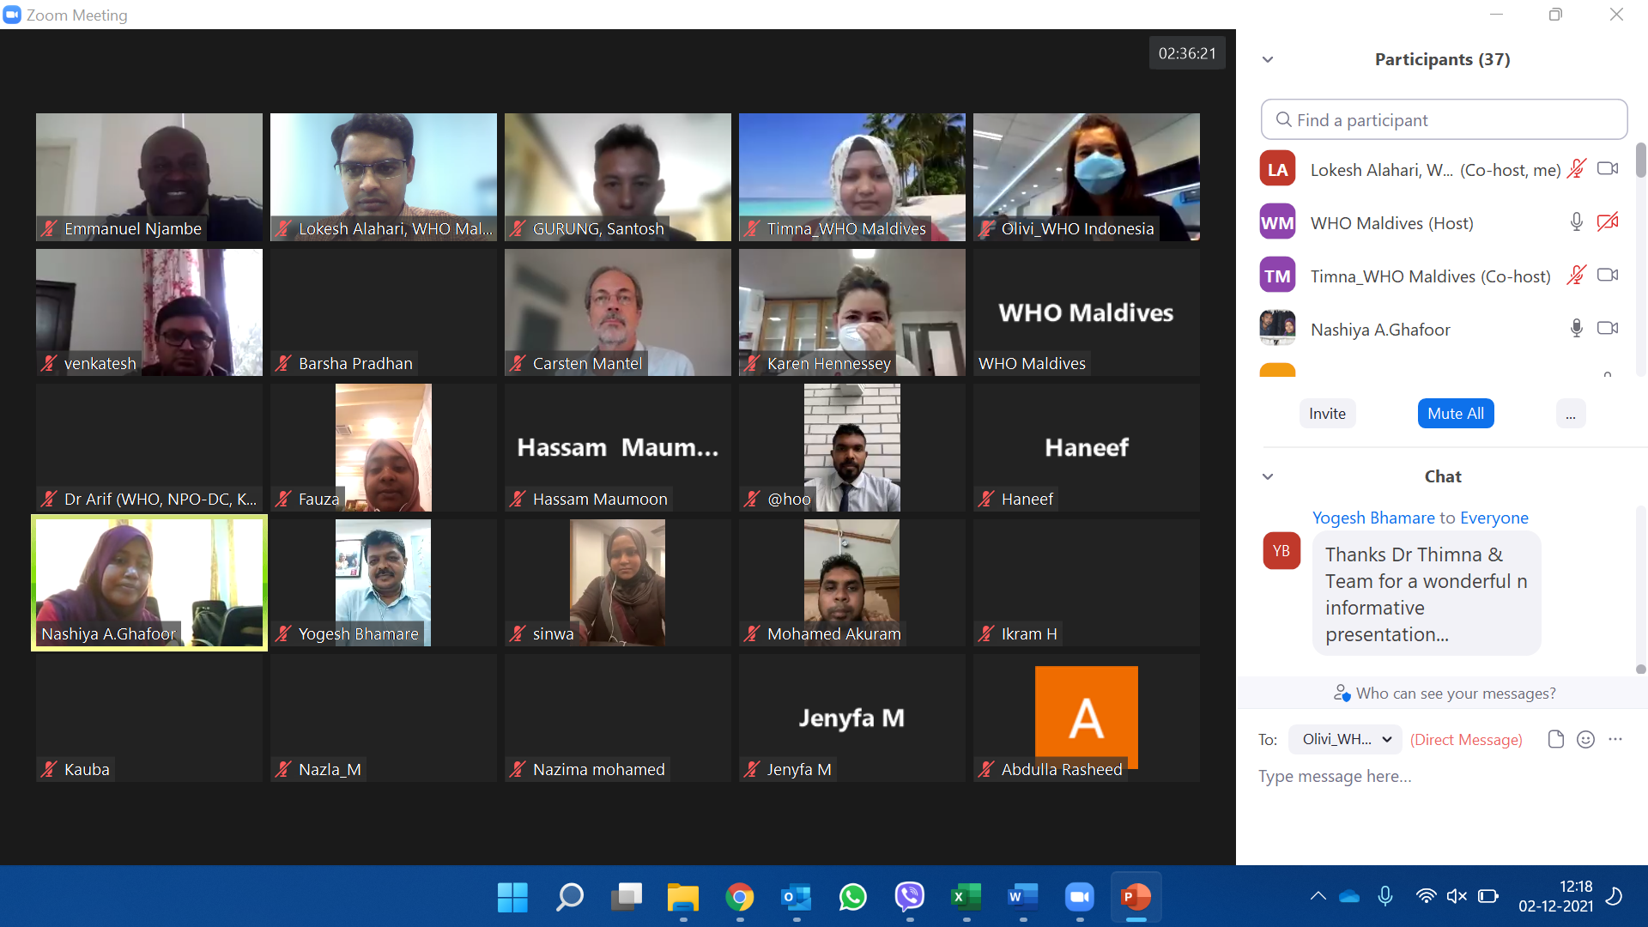
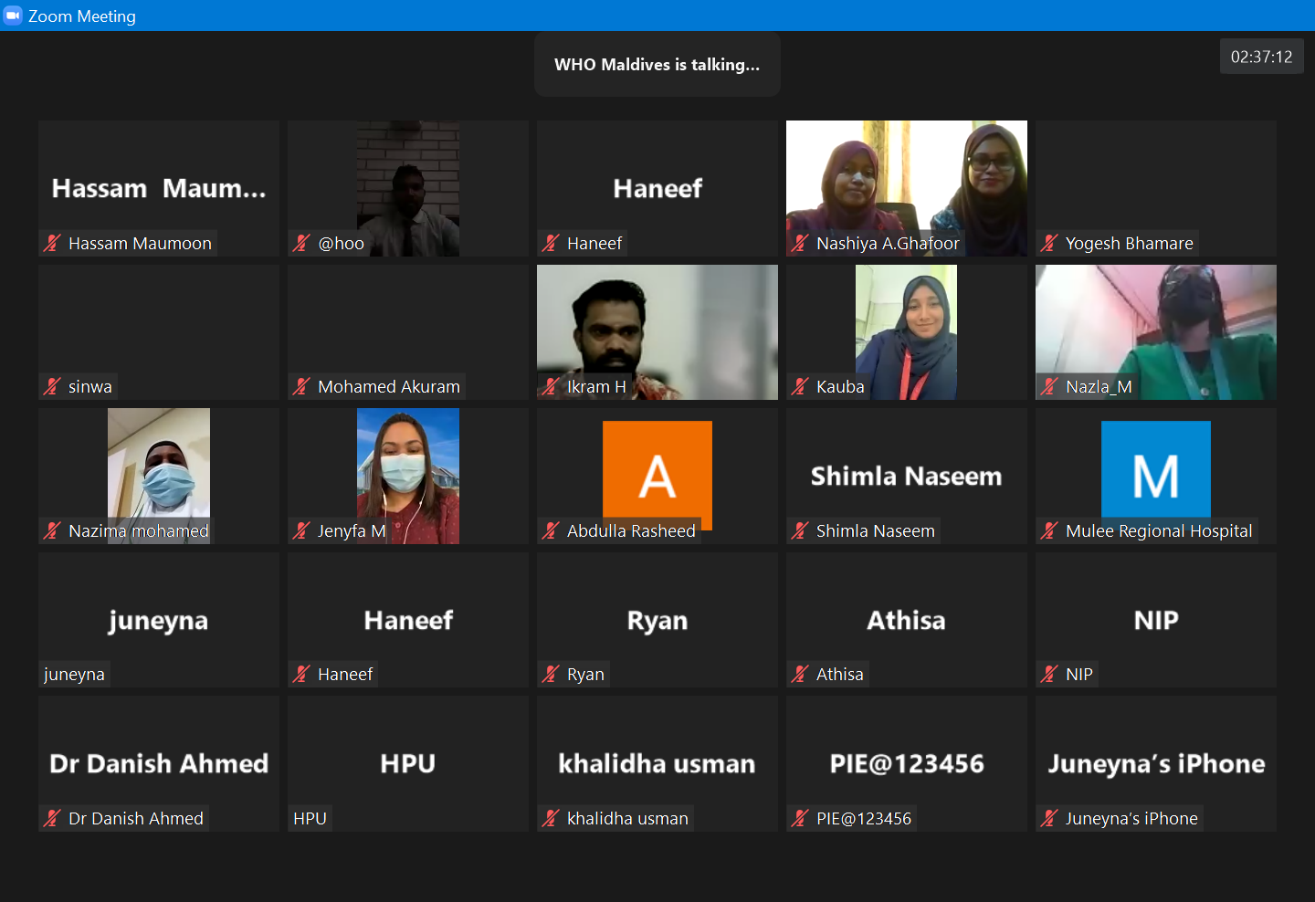
Preparatory activities for PIE
Conceptualizing of classic PIE amidst pandemic
Mobilizing national and international experts
Adopting questionnaires and tools to the country context
Developing the web tool and field testing
Regular preparatory coordination meetings among all three levels of WHO
Planning and coordinating with national, atoll, island focal points
Virtual trainings and orientations

Slide 7
Process of Evaluation
Followed methodology for a classic cPIE as per WHO interim guidance:
Desk review of relevant background documents
Field visits to conduct interviews and inspection of sites at all levels (7 atolls and Male’ region)
Each team was led by an external assessor (international expert)
Stakeholder engagement and discussions
Compilation and analysis based on thematic areas
Briefing and debriefing meetings

Slide 8
Evaluation areas
1. Regulatory Preparedness
6. Human Resources Management and
Training
2. Planning and Coordination
7. Vaccine demand, advocacy &
communication
3. Service delivery
8. Vaccine Safety Monitoring
Management of AEFIs and Injection Safety
4. Costing and & funding
9. Monitoring & Evaluation
5. Supply Chain
Management and Health Care Waste
10. COVID-19 Surveillance

Slide 9
Number of site interviews by health administrative level
 | Health administration level | Interviews planned/ Conducted | % Interviews conducted
COVID-19 vaccine Questionnaires | National/Central Level | 1 / 1 | 100%
 | Covid - National Stakeholder Form | 3/3 | 100%
 | Covid - Atoll Level | 8/8 | 100%
 | Covid - Island Level | 12/12 | 100%
 | Covid - Storage Observation | 19/19 | 100%
 | Covid - Vaccination Session Observation | 6/22 | 27%
 | Covid - Health Worker Priority Group | 18/19 | 95%
 | Covid - Priority Group | 41/40 | 102%
 | Covid - Resort or Industrial Islands | 8/8 | 100%
HPV Vaccine Questionnaires | HPV - National Level | 1/1 | 100%
 | HPV - Atoll/Island Levels | 20/20 | 100%
 | HPV - Ministry of Education & Schools | 19/20 | 95%
 | HPV - Interview with Parents & Girls | 20/20 | 100%
 | Total | 176/ 193 | 91%

Slide 10
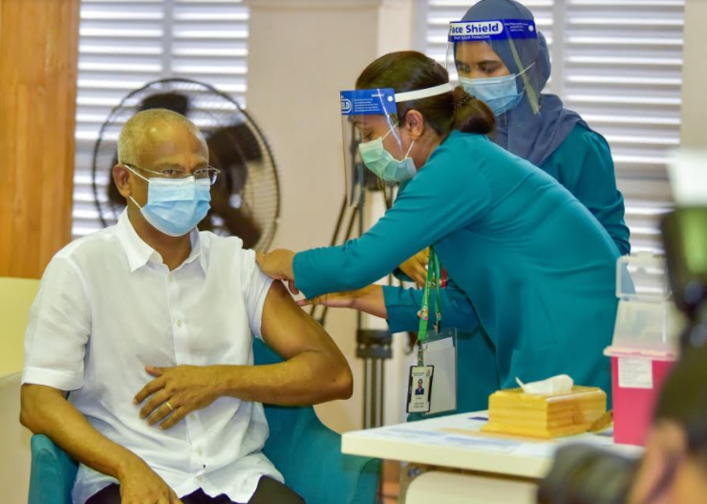
Key Strengths (1)
Exemplary planning in deployment of COVID-19 vaccines
Maldives Food and Drug Authority (MFDA) was able to fast track and expedite authorization guided by WHO
NDVP available and updated
Equity based vaccine roll out, with inclusion of all residents including expatriates and undocumented migrants
Prioritization of beneficiary groups were in line with the SAGE prioritization roadmap

Slide 11
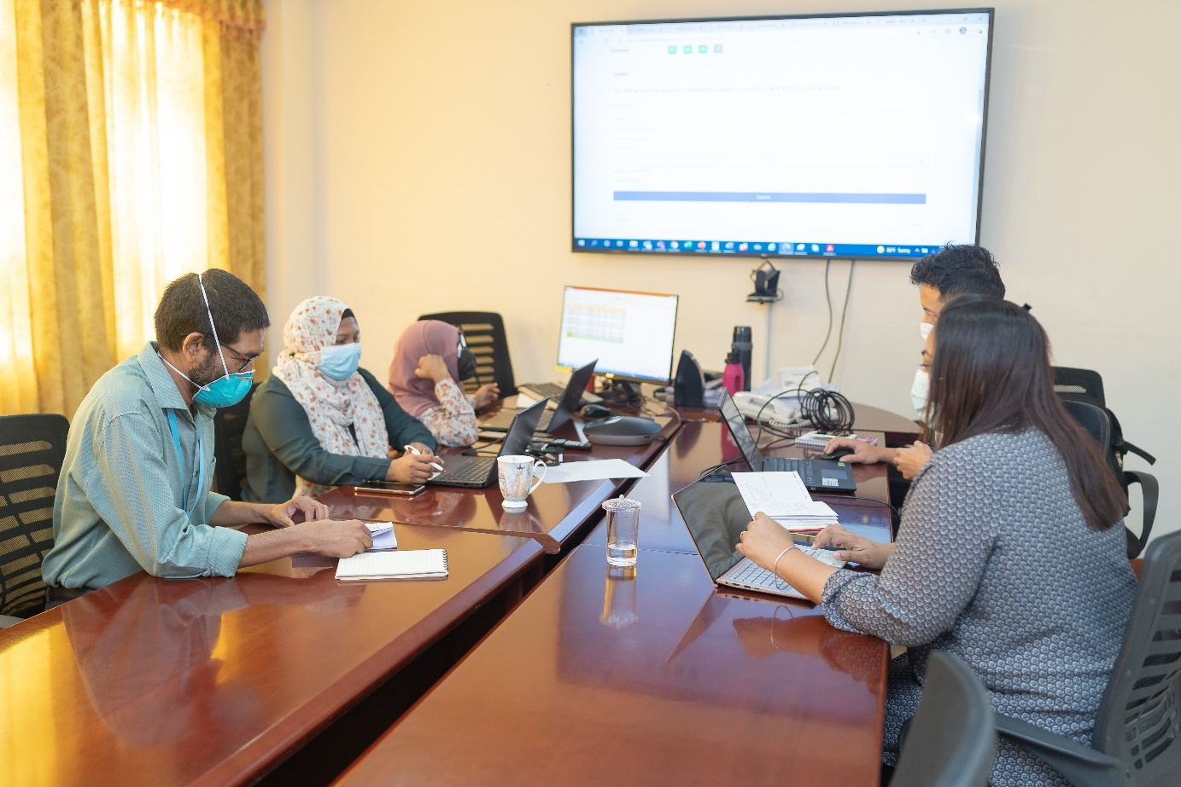
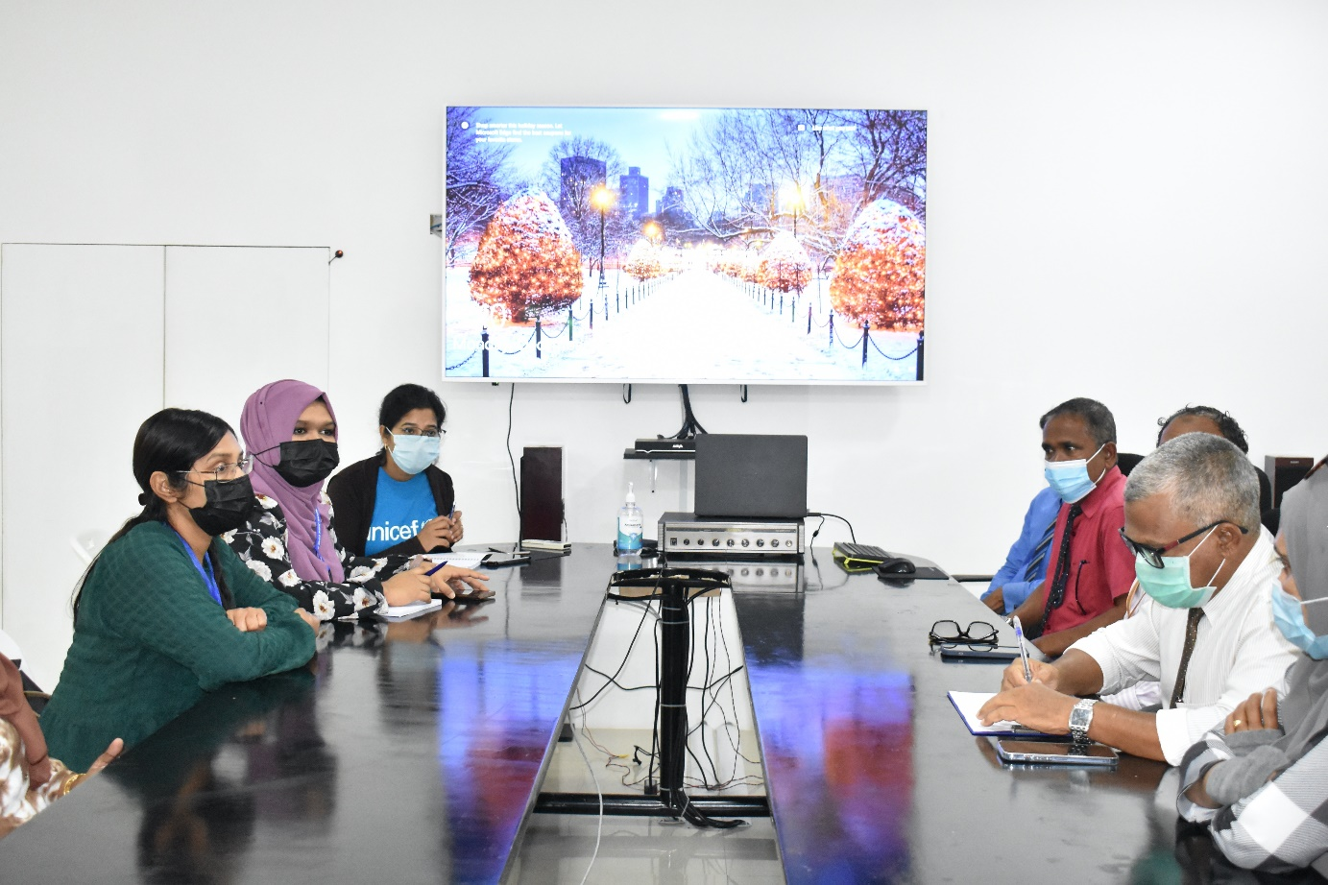
Key Strengths (2)
Proactive efforts in securing vaccine supplies
Continuous guidance and monitoring from MTAGI and AEFI Committee
High vaccine acceptance due to proactive communication and public trust in health system
Rapid dissemination of information and training materials to field staff through viber and google drive
Good use of virtual communications at all levels during lockdowns

Slide 12
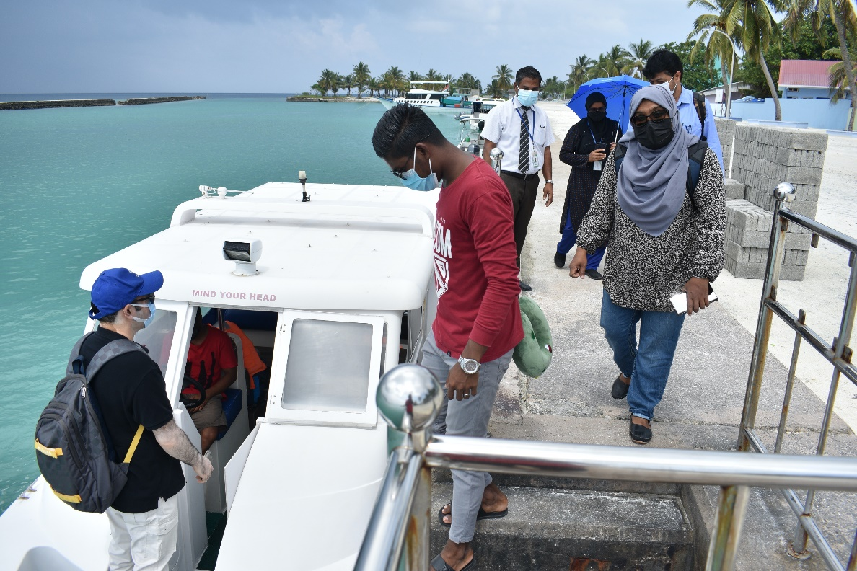
Key Strengths (3)
All modes of service delivery were observed including fixed & outreach session sites, mobile teams and campaign with mass vaccination centers
Innovative modes were employed; collaborative efforts with Ministry of Tourism for resort islands, mobile teams for bed-ridden people
Vaccine distribution to islands was done through multiple modes of transport available in country (airplanes, seaplanes, ferry, speed boats)
Additional clinical staffs and volunteers were assigned for mass vaccination centres

Slide 13
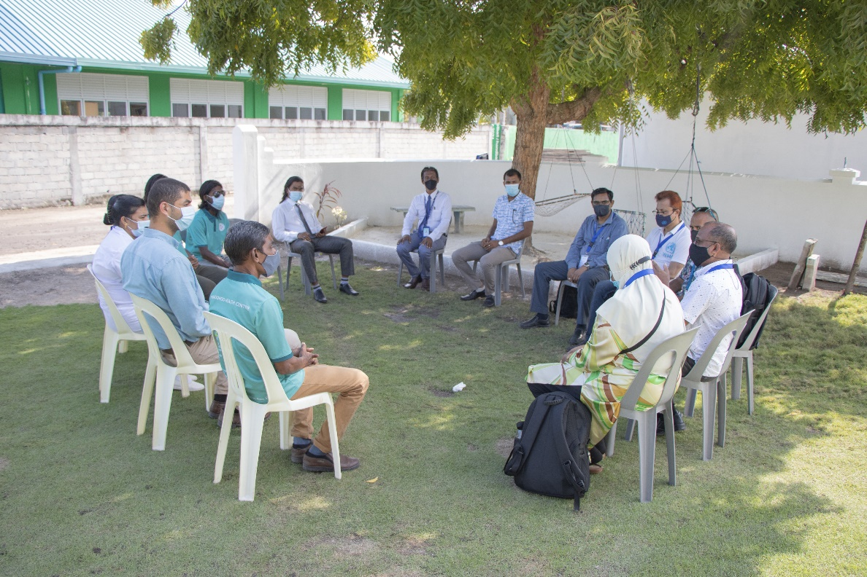
Key Strengths (4)
24/7 hotline for healthworkers and doctors to report and guide in management of AEFIs
All AEFI procedures are followed as per the National AEFI guidelines
Safety boxes used in all facilities and IPC measures observed
Management of crisis communication at national level
Responsive national/atoll focal points to take questions and guide field personnel

Slide 14
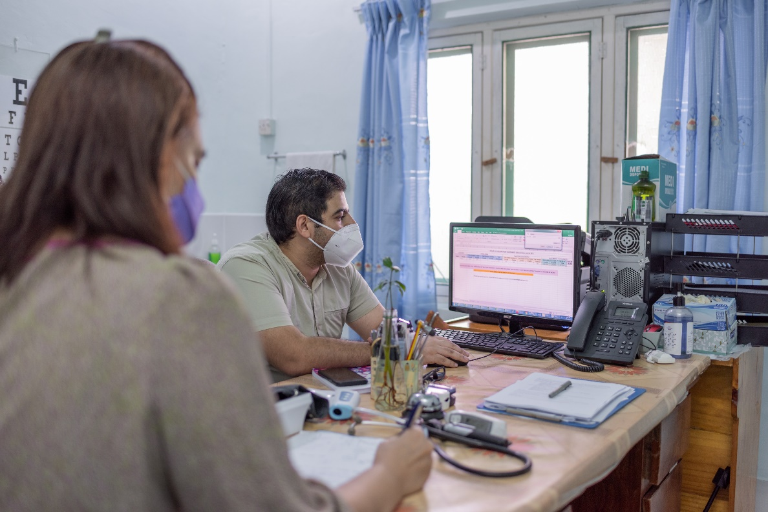
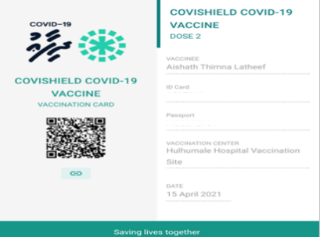
Key Strengths (5)
Web-based real-time portal for COVID-19 vaccination- DHIFAAU portal
Both manual vaccination card and digital vaccination certificate with QR Code
Routine immunization services maintained during pandemic
Overall: The COVID-19 vaccination response led to cold-chain upgrades, reinforcement of AEFI monitoring, and strong community appreciation & awareness of the benefits of vaccination
Maldives Joint COVID-19 and HPV Vaccines PIE: December 2021

Slide 15
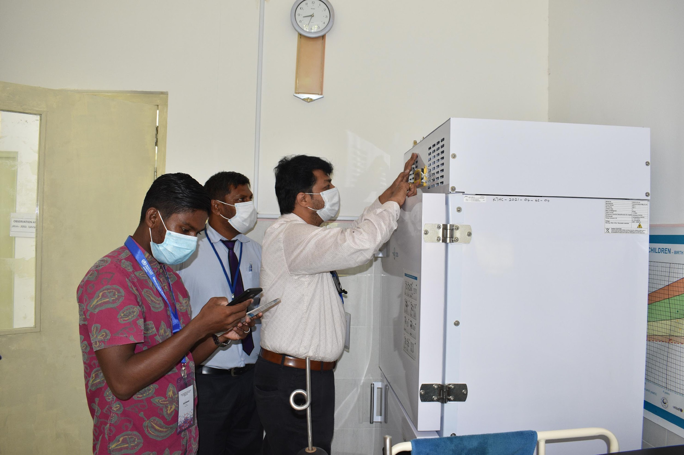
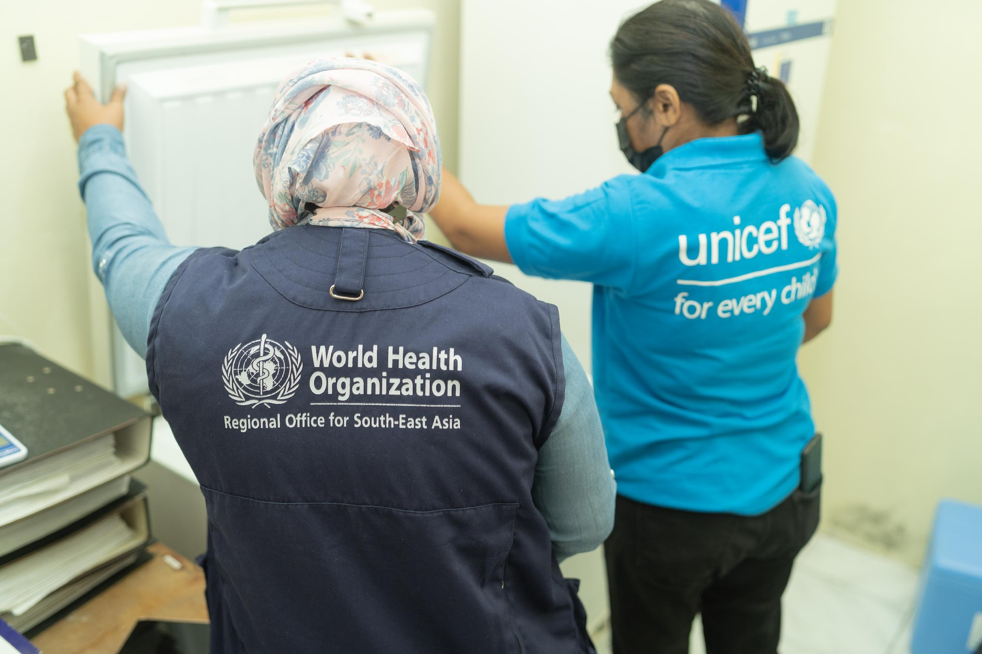
Key Challenges
Over-stretched human resources
Lack of supervision
Lack of atoll/island operational funds for local needs
Gaps in oversight and quality control checks of vaccines supply arriving in country
Duplication and inefficiencies in data reporting systems, minimal data analysis
Gaps in cold chain, temperature monitoring, and immunization waste management

Slide 16
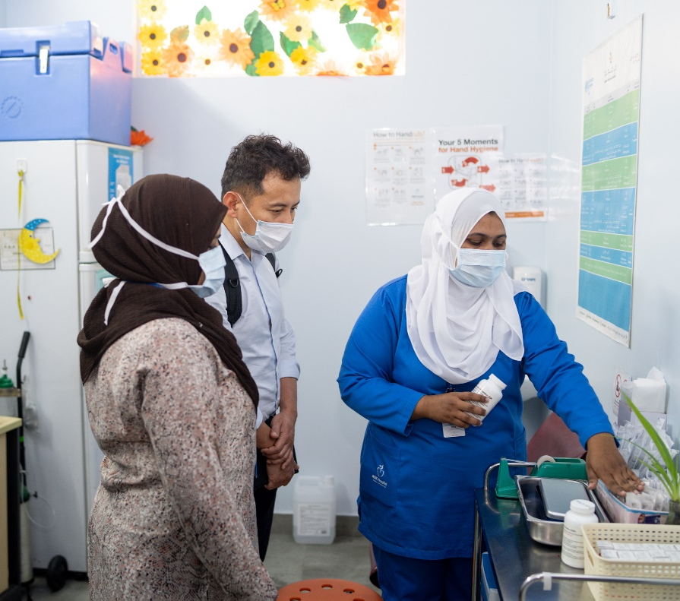
Key Recommendations (1)
Identify ways to decrease the staff workload (task-shifting, community engagement, additional staff, etc.)
Recognize staff for remarkable commitment
Establish clear SOPs for vaccine quality control & off-label use of vaccines (extended expiry of Pfizer)
Revive and ensure funding for supportive supervision and operational funds for atolls/islands

Slide 17
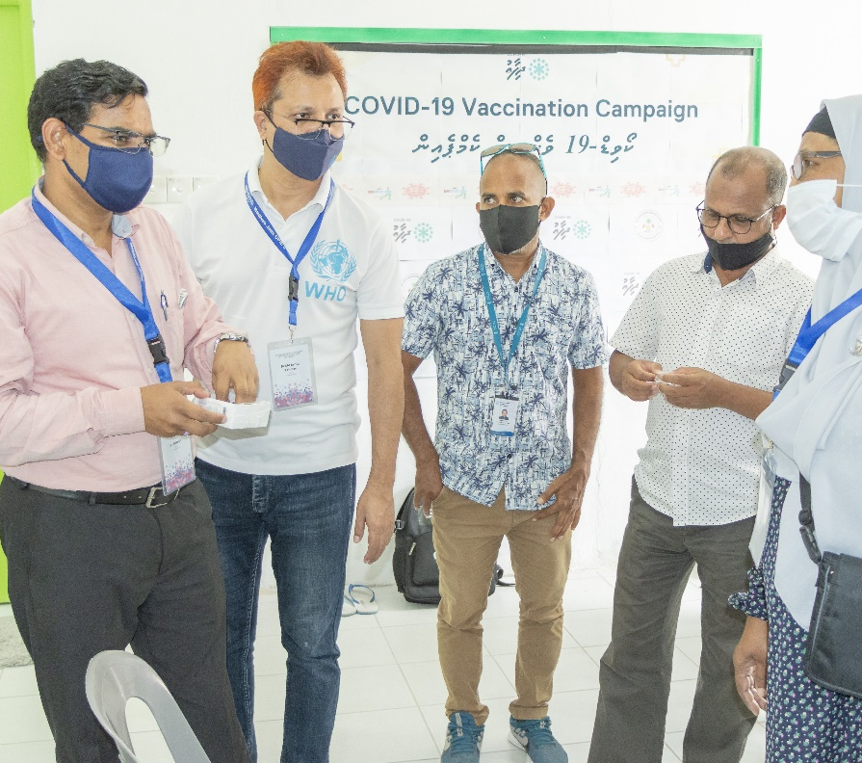
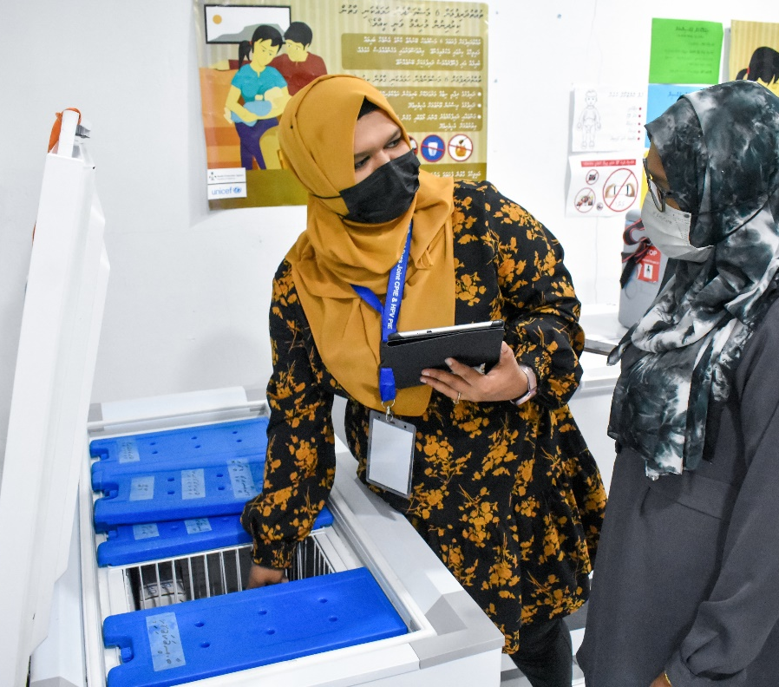
Key Recommendations (2)
Address gaps in cold chain, temperature monitoring gaps, and waste management
Develop mechanisms or provide instructions for re-distributing vaccines to prevent wastage due to expiry
Prioritize the design and implementation of a comprehensive electronic immunization registry that facilitates data analysis and guides routine immunization activities

Slide 18
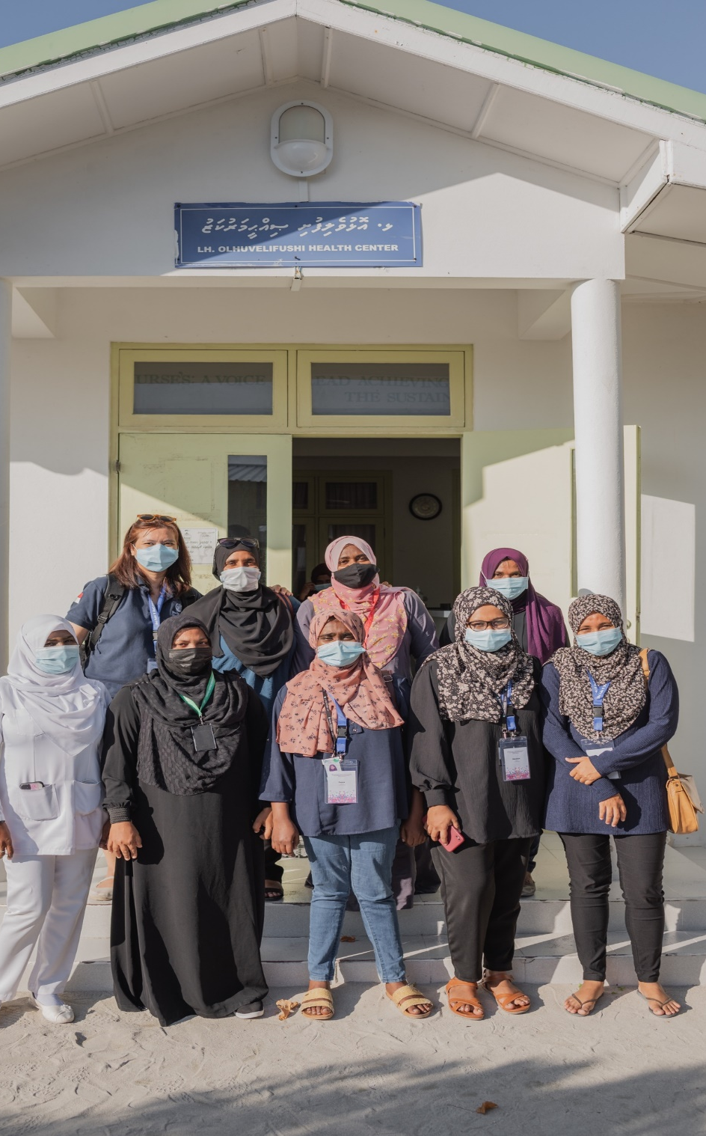
HPV vaccination: Key Findings
Good acceptance and high reported coverage with both doses of HPV vaccine
Strong collaboration and coordination with stakeholders, especially Ministry of Education in both the campaign and subsequent integration into routine immunization schedule
HPV vaccine-specific challenges identified include:
Low awareness and misunderstanding of HPV vaccine benefits among girls, parents and professionals (health workers & teachers)
Vaccine supply issues: expired vaccine and lack of calculating wastage
Data issues: inconsistent sources used for estimating the target population, minimal data analysis; not calculating drop-out rates, multiple manual records and irregular reporting to national level

Slide 19
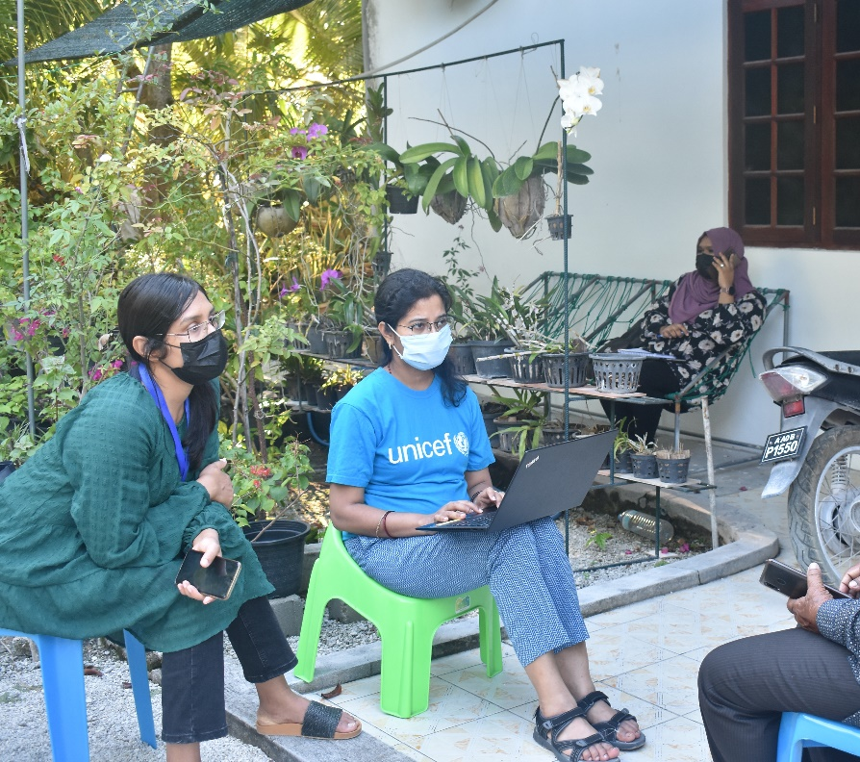
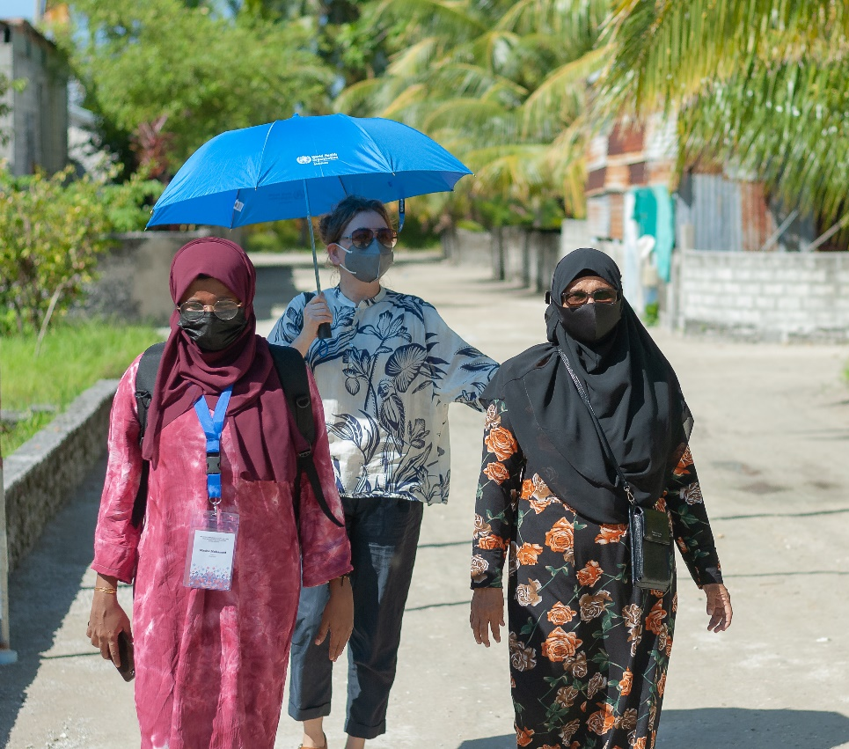
Key Lessons for planning PIE (1)
Strong coordination and planning is the key for successful implementation of PIE
Securing international assessors and external partners as per the needs of the assessment
Customization of tools and questionaries should be planned well ahead
Field test the tools well in advance and quantify the time required for assessments
Virtual orientation and briefing session to assessors before arriving to the country helped

Slide 20
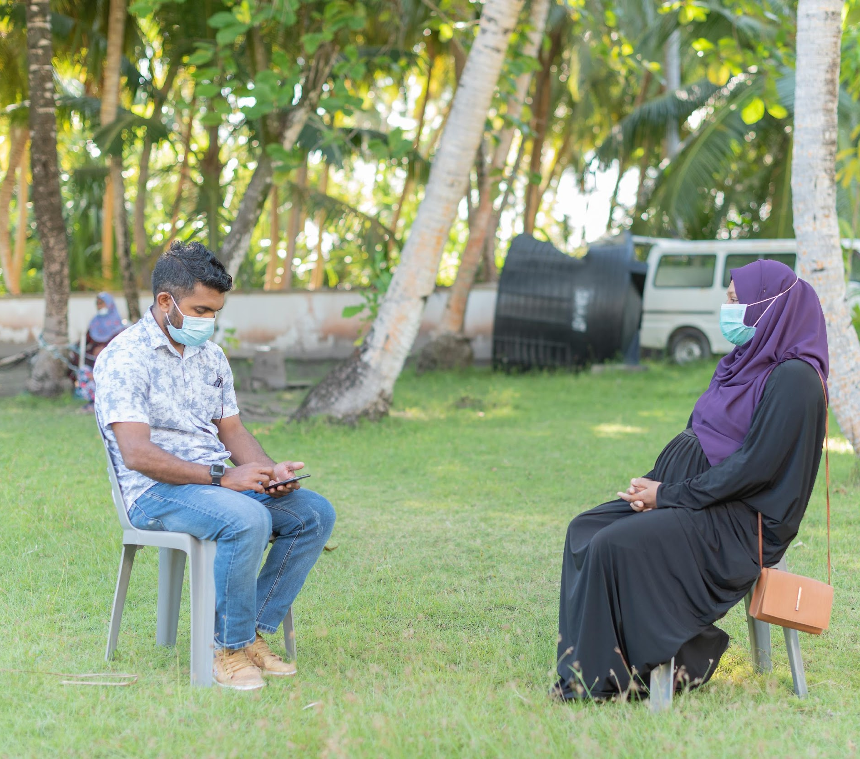
Key Lessons for planning PIE (2)
Emphasis on COVID appropriate behaviours during assessment
Using social media platforms and groups to be well connected
Photographers may be assigned to teams for documentation purpose
The Web portal has been prepared as a global good so that other countries can adopt and use if needed
In upcoming cPIEs for other countries, consider to include a component to see how covid-19 vaccination is being integrated within the RI services

Slide 21
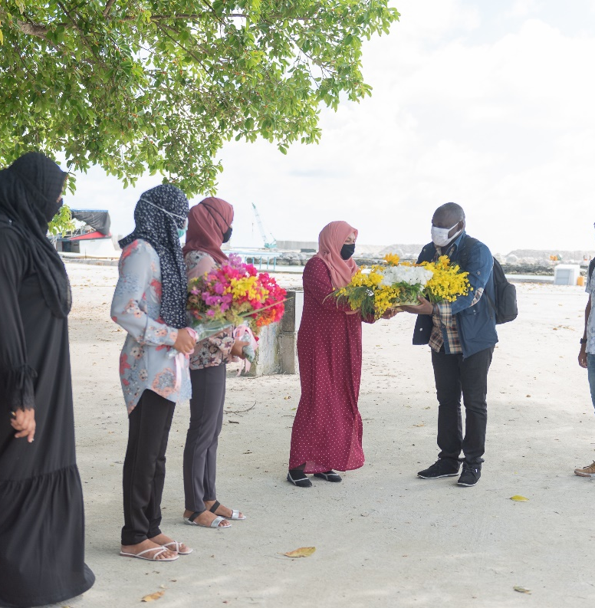
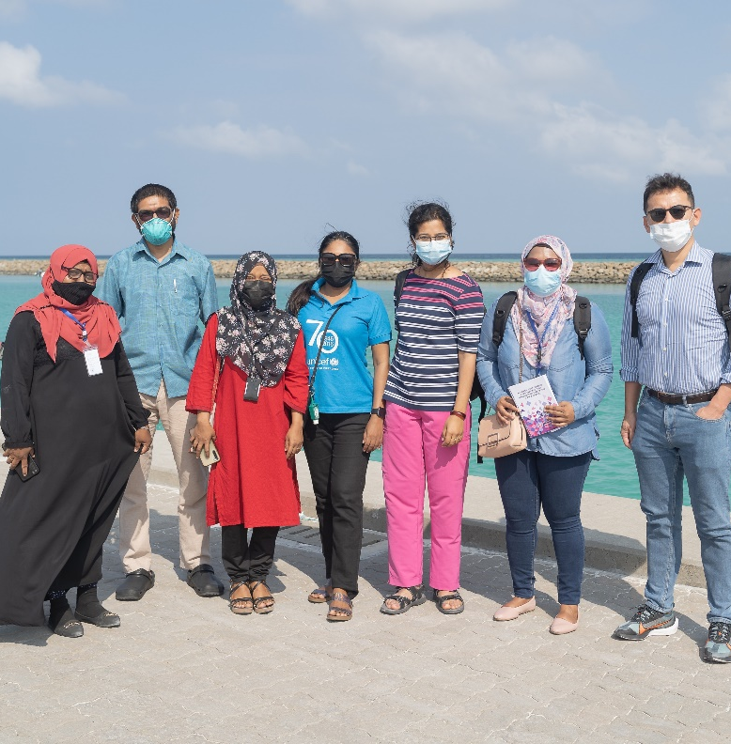
Acknowledgements
Health Protection Agency, Ministry of Health, Maldives
Islands/resorts/ schools/ Atoll focal points and teams
Male’ region immunization centre focal points
Island Communities
MTAGI, National AEFI committee
UNICEF Country office, Maldives
UNICEF ROSA
CDC India
MM Global Health
Gavi for funding support under AMC
WHO Country offices - Bangladesh, India, Indonesia
WHO SEARO IVD team
WHO HQ
WHO Country office (Team MMT)

Slide 22
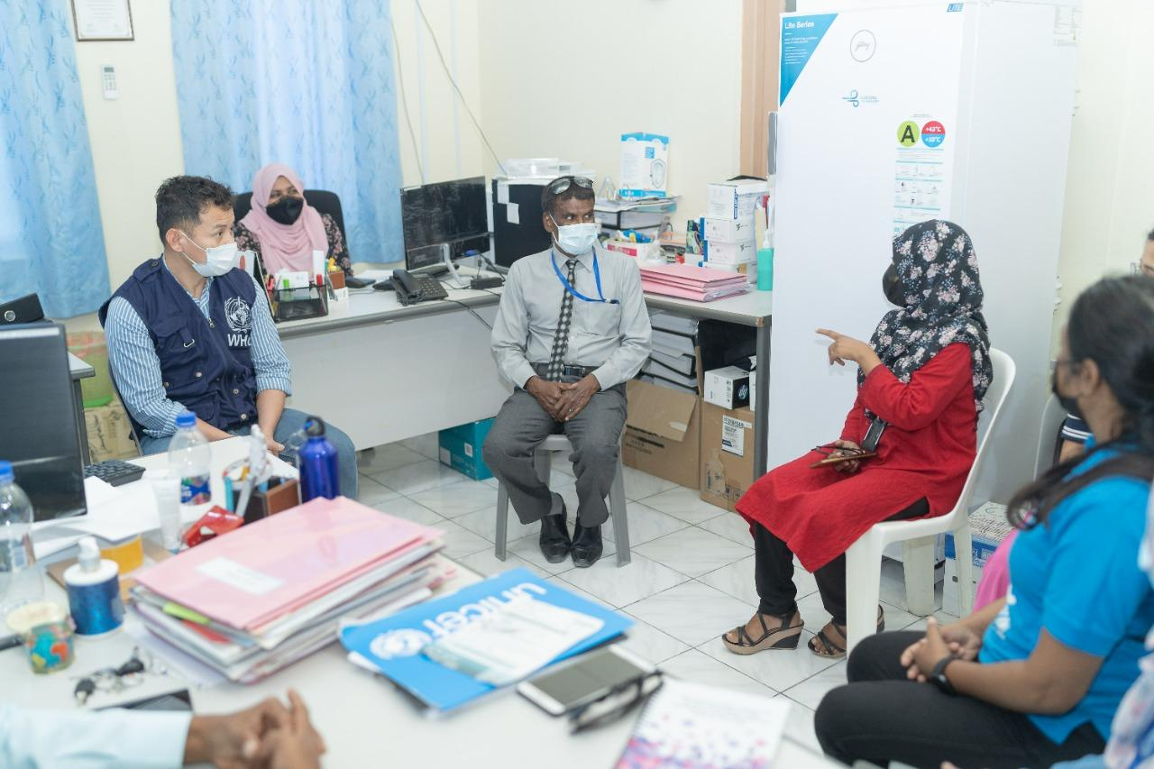
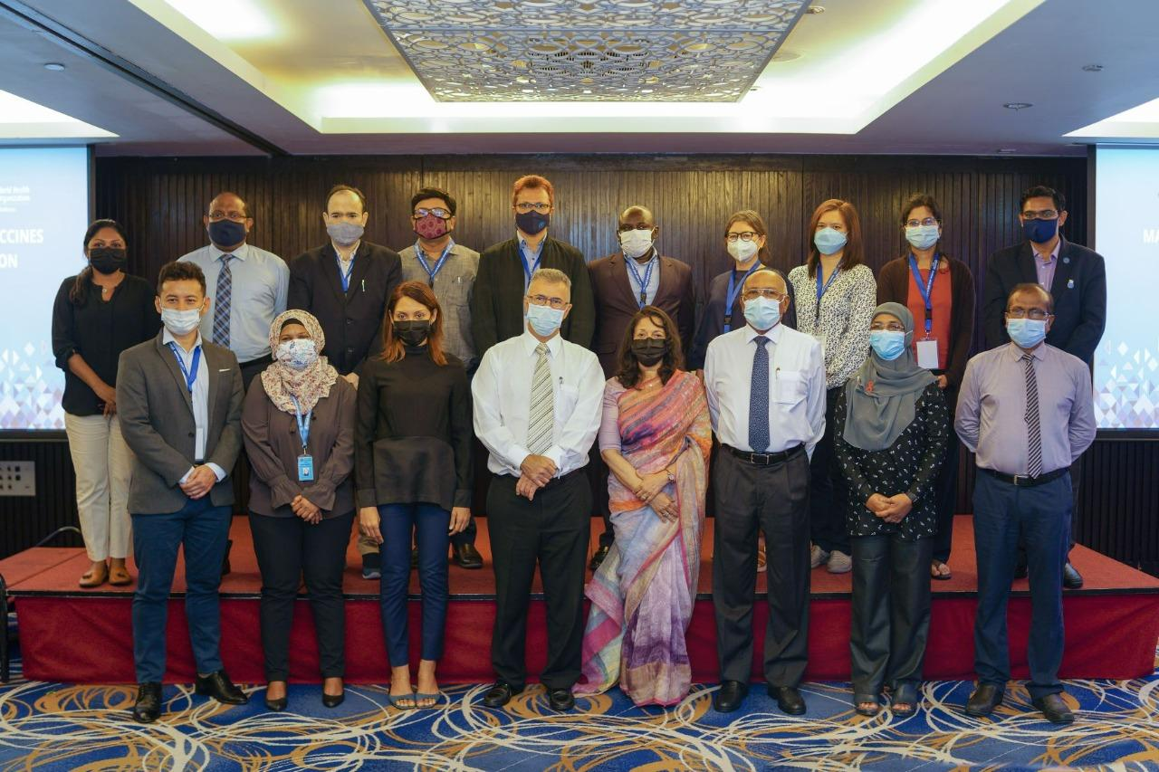
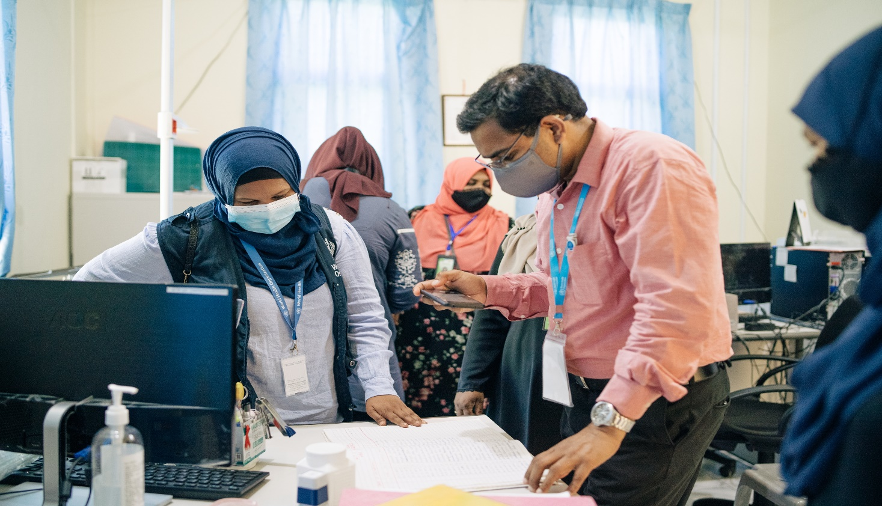
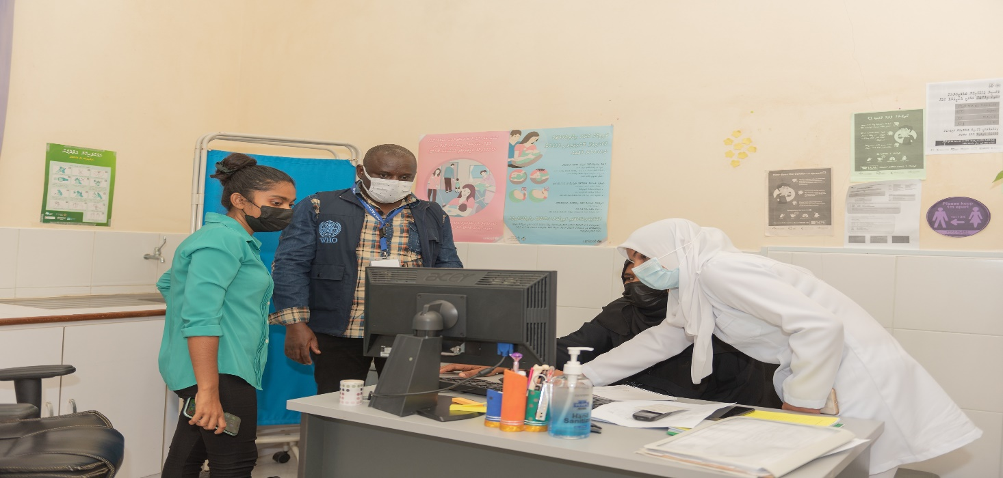
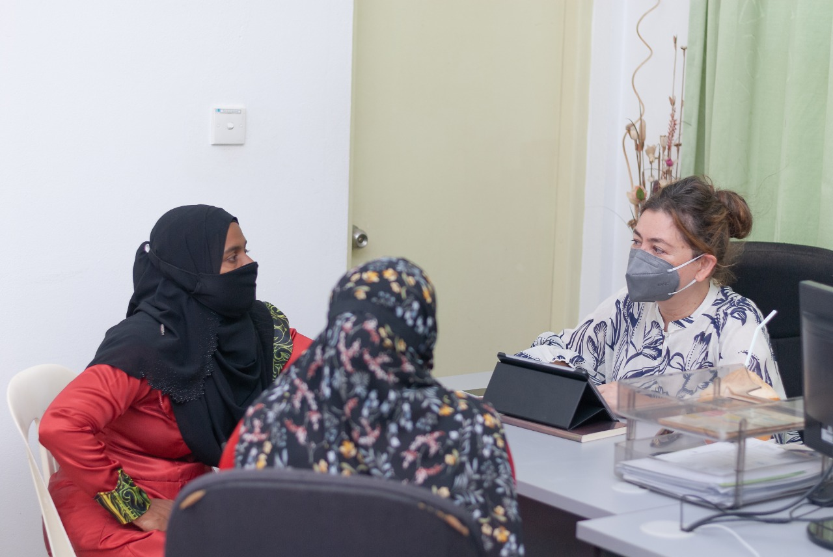
Thank You

