Slide 1
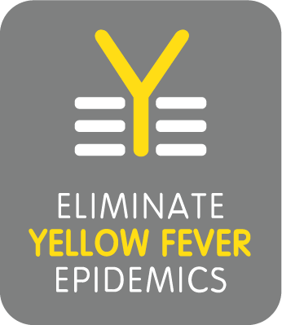
Challenges around continuation of yellow fever activities in COVID-19 context

Slide 2
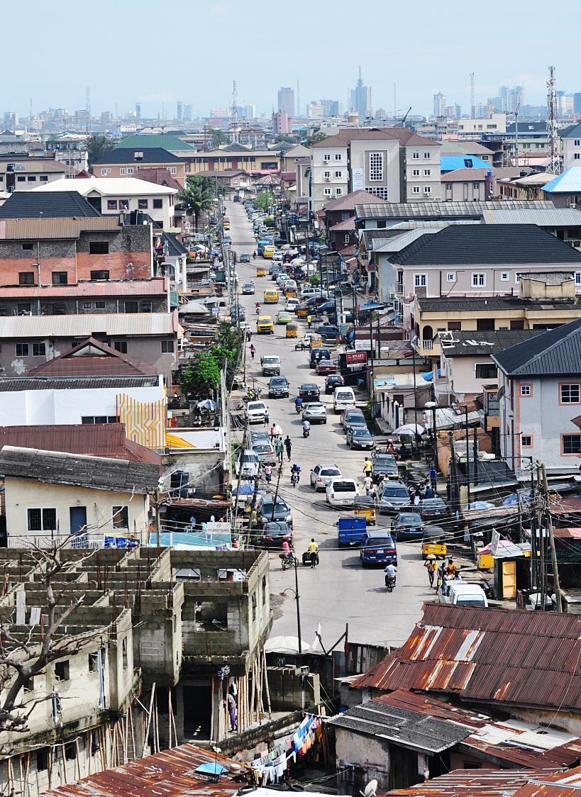
A continuing threat to global health security
High-impact disease endemic in 3 regions (AFRO, EMRO, PAHO) but risk of spread and extension exists
Wildlife reservoir that cannot be controlled
At the crossroads of epidemic-prone, vaccine-preventable and vector-borne diseases
Sustained risk mitigation efforts needed
YF urban outbreaks are dramatic events
The EYE partnership aims to
Protect at-risk populations (vaccination, risk prioritization)
Prevent international spread (urban readiness, at-risk workers, IHR)
Control outbreaks rapidly (surveillance, Dx, international samples transport, emergency vaccines, immediate response)

Slide 3
COVID-19 increased YF risk on short and long terms and reduced capacity to detect and confirm YF events early
Delayed outbreak response
Ethiopia - Uganda - South Sudan
Decreased surveillance
67% reduction in number of samples received by national labs compared to same period last year
Operations/Logistics affected by lack of transport routes and rising costs (e.g. tripling of shipping costs in certain contexts).
Delayed or disrupted preventive immunization activities
RI disruptions (no quantifiable data available yet, but modelling in progress)
Initial pulse survey clearly indicates disruptions, hesitancy of caregivers to access immunization services, safety concerns by HCWs, e.g. Brazil has maintained YF RI in affected areas but uncertainty persists on community readiness to receive those services.
Programmatic, epidemic, resources and partnership risks identified, assessed and monitored including delays to EYE implementation due to shifting priorities and complexity of virtual working environments
Opportunities
Integration of YF into COVID surveillance efforts, Grouping of samples from different pathogens…
Need to quantify impact on accumulation of susceptibles
Notes:
Delayed outbreak response
Ethiopia - challenges with defining specific COVID risk mitigation measures in absence of clear guidelines; , challenges in mobilizing resources for IPC supplies/PPE (ICG funds used).
Uganda - public health restrictions, lack of country prioritization, increase needs for COVID risk mitigation measures. Implementation 3 months post ICG approval.
South Sudan - uncertainty on ability to implement campaign in COVID context, lack of prioritization, challenges in mobilizing resources for IPC supplies/PPE (ICG funds used).
Decreased surveillance
67% reduction in number of samples received by national labs compared to same period last year
Operations/Logistics affected by lack of transport routes and rising costs (e.g. tripling of shipping costs in certain contexts).
Delayed or disrupted preventive immunization activities
RI disruptions (no quantifiable data available yet, but modelling in progress).
Initial pulse survey clearly indicates disruptions, hesitancy of caregivers to access immunization services, safety concerns by HCWs, e.g. Brazil has maintained YF RI in affected areas but uncertainty persists on community readiness to receive those services.
Programmatic, epidemic, resources and partnership risks identified, assessed and monitored including delays to EYE implementation due to shifting priorities and complexity of virtual working environments
Opportunities
Integration of YF into COVID surveillance efforts, and EYE programme efforts to ensure continuity of YF control activities.
Grouping of samples from different pathogens, when possible and when to be delivered to the same reference laboratories (Int. samples transport ops).

Slide 4
Continued delivery of YF activities during COVID despiste challenges
From mitigating the impact of COVID per se (2020) to mitigating the COVID vaccine roll-out (2021)
Priorities were to:
Ensure continuation of essential services to prevent or control outbreaks
Prepare for post “acute COVID” times and log term implementation of preventive activities
About 45 million people protected against YF for life by mass vaccination campaigns in Nigeria and Ghana.
An additional 2.4 million people protected by outbreak responses in Ethiopia, South Sudan and Uganda.
Over 140 million people protected against YF since inception of the EYE strategy via large-scale vaccination.
Although 2020 achieved 60% of initial target (DRC campaigns postponed to 2021), twice as much people protected in 2020 compared to 2019.

Slide 5
Key tools to mitigate COVID-19 impact
A well-functioning partnership
Leveraging existing structures and platforms
Rapid situational awareness toward solutions
Engagement with other programmes to seek efficiencies and integration
Re-orient priorities to meet countries’ needs
Empower countries to investigate and manage YF (e.g., ICG request package; PCCS methods for reactive context)
Support countries to leverage COVID-19 surveillance efforts to enhance YF surveillance in high-risk areas
Risk register to guide and monitor our mitigation strategy
Calls to action to fulfill commitments, respond to countries needs and continue to provide essential services
Prepare for post-COVID

Slide 6
> 140 million people protected via yellow fever (YF) mass vaccination since EYE strategy inception with >53 million additional planned in 2021
Status | Country | Activity & scope | Target population | FCV context | Issue | Comment
 | Sudan | Catch-up unprotected children & introduce YF vacc. into routine immunization | 5.6 million catch-up + 1.5 million (yearly) | Yes | Central level resources stretched due to COVID-19 vaccine roll-out. | Activity dates pending for RI introduction & remaining catch-up. 5-dose vials arrival expected June.
 | Sudan | Phase 2 Catch-up (Sennar, Gedarif, Red Sea) & targeted Ethiopian refugees | ~550,000 | Yes | Central level resources stretched due to COVID-19 vaccine roll-out. | Kassala & Gedarif activities completed catch-up (YFV + IPV) + refugees outreach (YF + OCV). Red Sea pending.
 | Rep. of Congo | Single phase preventive mass vaccination campaign | 4 million | NA | Campaign at risk of delay. Multi-partner coordination calls not yet endorsed, COVID-19 vaccine roll-out impacting. | Standard is to initiate country calls ≥6 m prior to campaign, pending as of 14 April 2021.
 | Nigeria | Phase of nationwide, multi-year preventive mass campaigns | 26.2 million | Yes, Borno &NE | Central level resources stretched due to COVID-19 vaccine roll-out, with coordination call postponed. | Many non-polio campaigns compacted in Q3/4, gap in country-calls X >1 month. Original start date was March 2021 (decision letter in March)
 | Uganda | Introduction of YF vaccine into routine immunization | 1.6 million (yearly) | Refugee | Support to RI introduction in RO workplan but not yet initiated. | Standard is to initiate ≥6m prior to new vaccine introduction. Decision letter pending.
 | DRC | First phases of nation-wide multi-year preventive mass campaigns | 18.4 million | Yes | Risk of delays secondary to country context. | Phase 1 &2 PMVC delayed >1yr to April – May, Equateur delay until July Newly added 300,000 refugees on 12 March 2021 . Ongoing logistics challenges.
KEY: On-track At-Risk / support gaps Delays
Notes:
Over 53 million people planned to receive YF vaccine in 2021 through combination of preventive mass vaccination campaigns (PMVC), new routine introduction (RI) and catch-up activities
Nb:
Sudan – As of 12 March, country updated that 100,000 dose YF (9m-60y), OCV and MCV (for <15) will be launched 21 March. Initially anticipated around 28 Feb then pushed to 8 March. Delayed from 8 March secondary to competing activities and currency exchange rate. The dates of delivery for 5-dose vials for RI introduction are yet to be confirmed.
Rep of Congo is nation-wide but excluding Pointe Noire (Pointe Noire was covered in 2018 reactive campaign)
Nigeria activity will include Kano and Borno. Other states yet to be confirmed
Updated titled to include >140million persons protected via EYE since inception (preventive & reactive), more than 53 million planned for protection in 2021. Children vaccinated through routine immunization would be in addition.

Slide 7
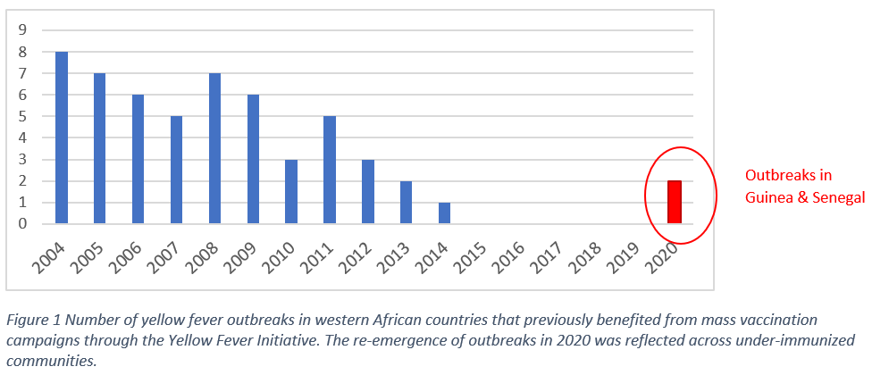
YF resurgence in West Africa countries with Hx of preventive campaigns
Notes:
Almost 50 million people planned to receive YF vaccine in 2021 through combination of preventive mass vaccination campaigns (PMVC), new routine introduction (RI) and catch-up activities

Slide 8
Quantifying the number of susceptibles in YF high-risk countries
Based on preliminary analysis, an estimated 1 in 10 eligible infants may have missed YF vaccination in 2020 secondary to COVID-19 disruption in Africa
More detailed analysis for all YF high risk countries will better quantify COVID-19 impact
Exploring options and concrete implications (feasibility; timeframe; RACI)
Scenario development by triangulating data based on 2020 JRF and WUENIC
Updating models of population immunity
Analysis using in-country DHIS2 (admin) coverages, similar to Nigeria
All options have trade-offs

Slide 9
Thank you
cibrelusl@who.int ; eye.strategy@who.int
For further information
https://www.who.int/initiatives/eye-strategy

